Slide 1
plant nomenclature

Slide 2
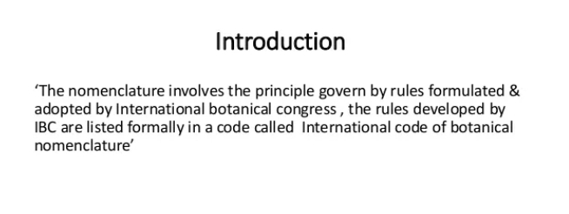

Slide 3
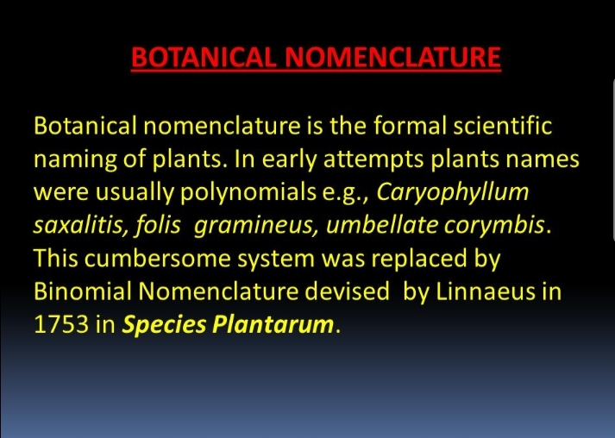

Slide 4
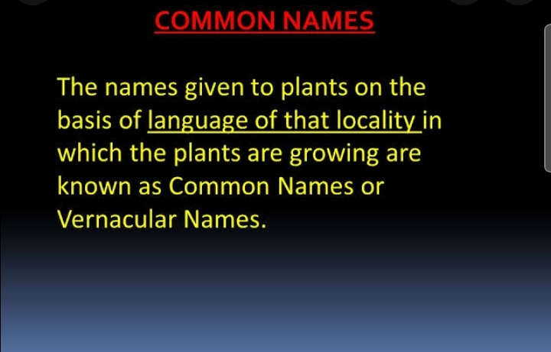

Slide 5
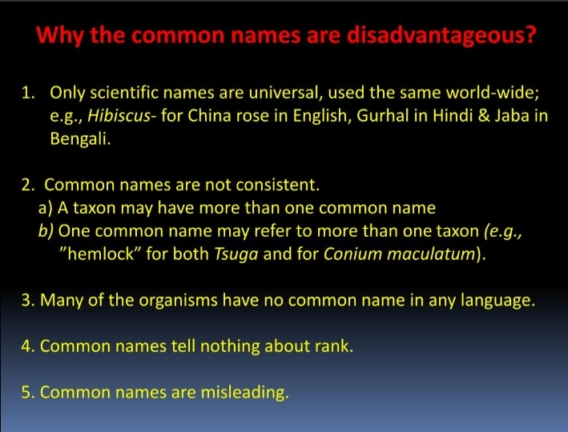

Slide 6
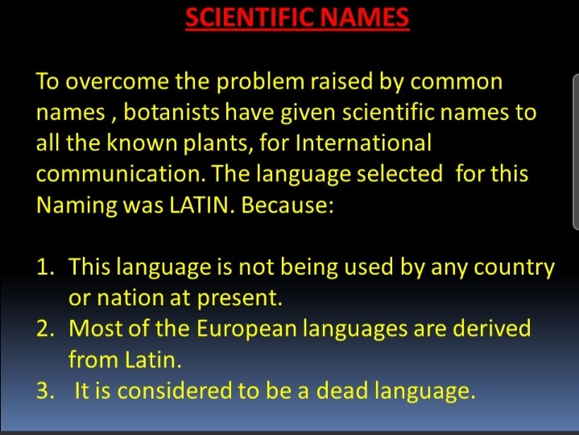

Slide 7
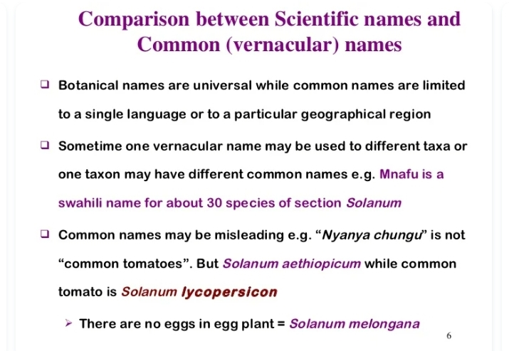

Slide 8
Preamble of the code
1. Botany requires a precise and simple system of nomenclature used by botanists in all countries, dealing on the one hand with the terms which denote the ranks of taxonomic groups or units, and on the other hand with the scientific names which are applied to the individual taxonomic groups of plants. The purpose of giving a name to a taxonomic group is not to indicate its characters or history, but to supply a means of referring to it and to indicate its taxonomic rank. This Code aims at the provision of a stable method of naming taxonomic groups, avoiding and rejecting the use of names which may cause error or ambiguity or throw science into confusion. Next in importance is the avoidance of the useless creation of names. Other considerations, such as absolute grammatical correctness, regularity or euphony of names, more or less prevailing custom, regard for persons, etc., notwithstanding their undeniable importance, are relatively accessory. 2. The Principles form the basis of the system of botanical nomenclature.
3. The detailed Provisions are divided into Rules, set out in the Articles, and Recommendations. Examples (Ex.) are added to the rules and recommendations to illustrate them.
4. The object of the Rules is to put the nomenclature of the past into order and to provide for that of the future: names contrary to arule cannot be maintained.
5. The Recommendations deal with subsidiary points, their object being to bring about greater uniformity and clarity, especially in future nomenclature; names contrary to a recommendation cannot, on that account, be rejected, but they are not examples to be followed.
6. The provisions regulating the governance of this Code form its last division.

Slide 9
7. The rules and recommendations apply to all organisms traditionally treated as plants, whether fossil or non-fossil, e.g., blue green algae (Cyanobacteria; fungi, including chytrids, oomycetes, and slime moulds: photosynthetic protists and taxonomically related non-photosynthetic groups. Provisions for the names of hybrids appear in Appl
8. The International code of nomenclature for cultivated plants is prepared under the authority of the International Commission for the Nomenclature of Cultivated Plants and deals with the use and formation of names for special plant categories in agricultural, forestry, and horticultural nomenclature.
9. The only proper reasons for changing a name are either a more profound knowledge of the facts resulting from adequate taxonomic study or the necessity of giving up a nomenclature that is contrary to the rules.
10. In the absence of a relevant rule or where the consequences of rules are doubtful, established custom is followed. II. This edition of the Code supersedes all previous editions.

Slide 10
1. Botanical nomenclature is independent of zoology nomenclature
2. The application of name of taxonomy groups is determined by means of the nomenclature types
3. The nomenclature taxonomic groups is based upon the priority of the publication
4.Each taxonomic group with a particular position & rank can only hare one correct scientific name
5•The scientific name of taxonomic group treated or written in latin language
6•The rules of nomenclature are retroactive unless expressly limited
Principles of the code

Slide 11
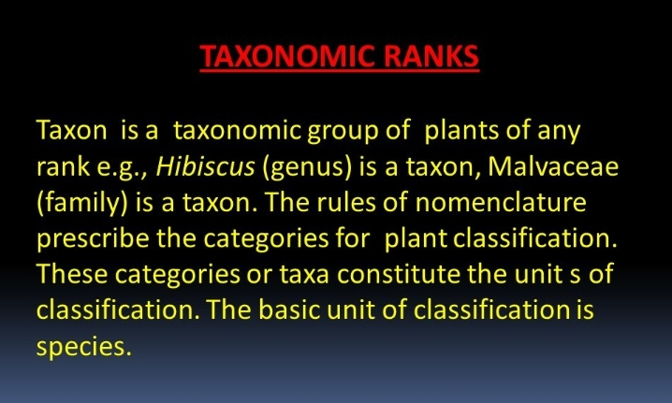

Slide 12
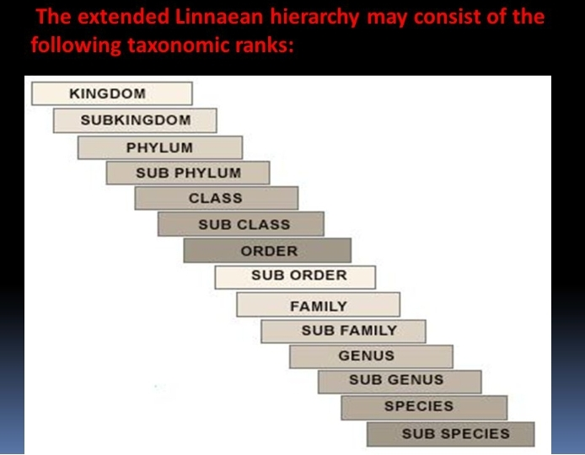

Slide 13
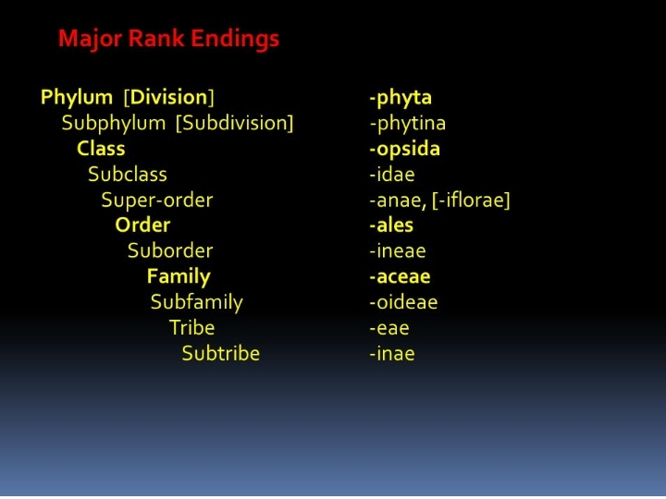

Slide 14
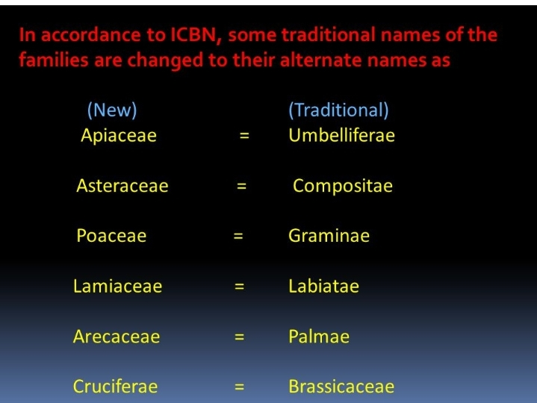

Slide 15
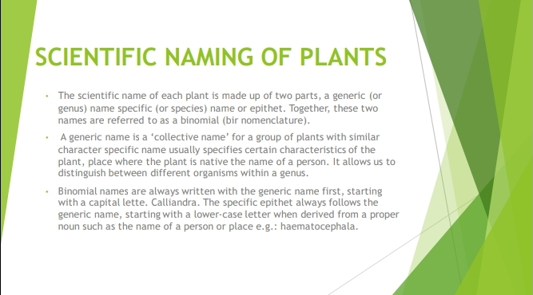

Slide 16
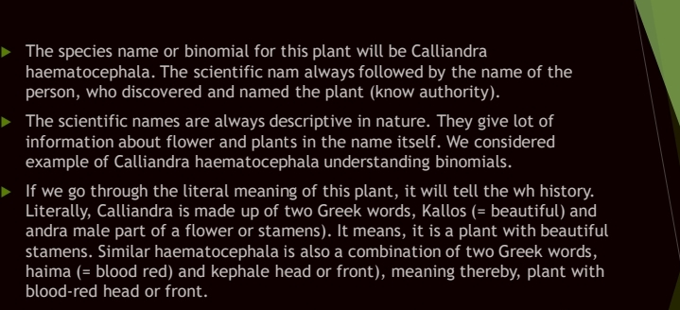

Slide 17
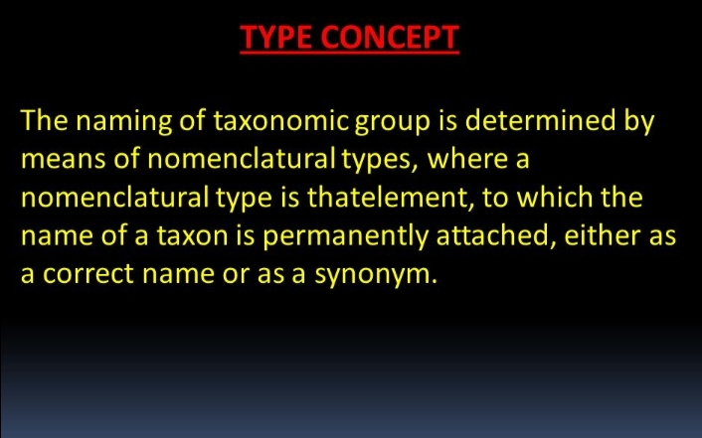

Slide 18
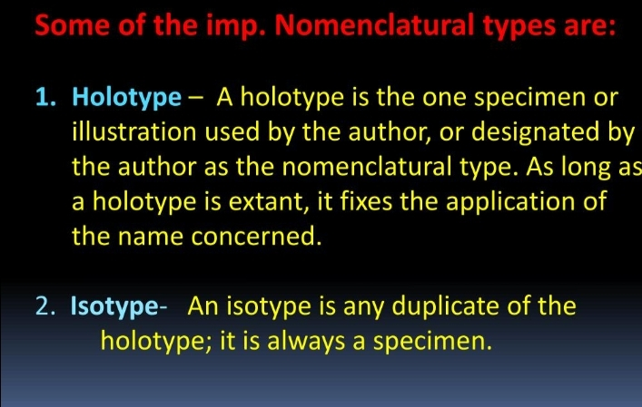

Slide 19
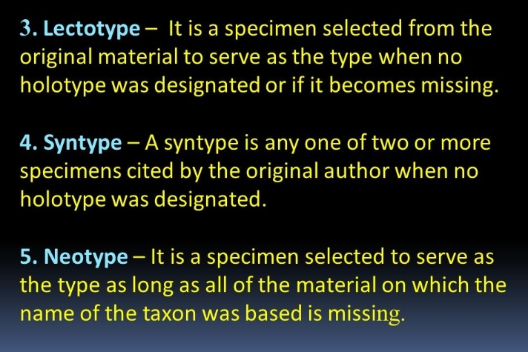

Slide 20
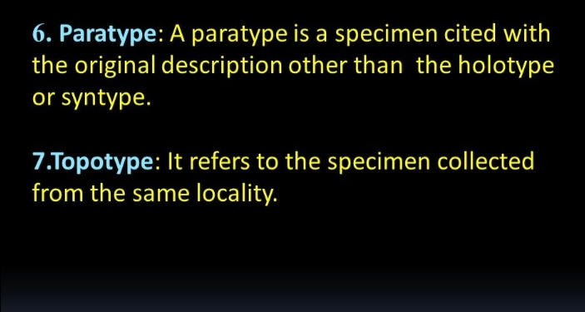

Slide 21
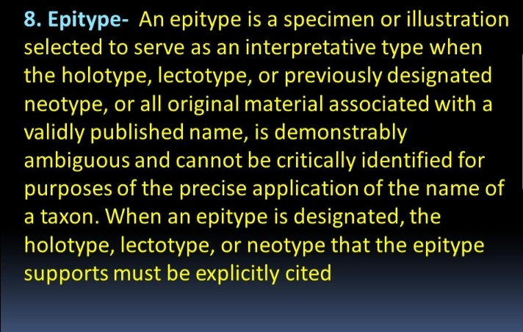

Slide 22
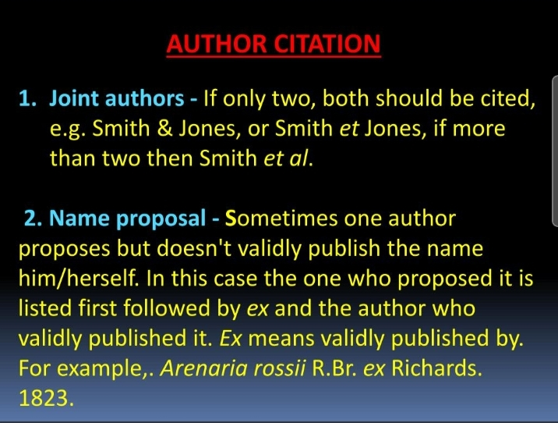

Slide 23
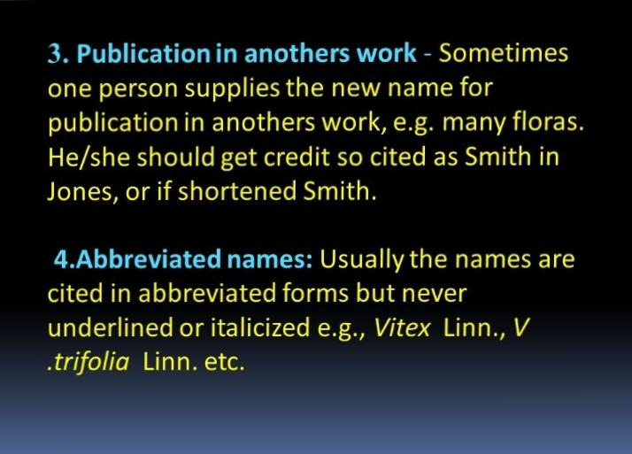

Slide 24
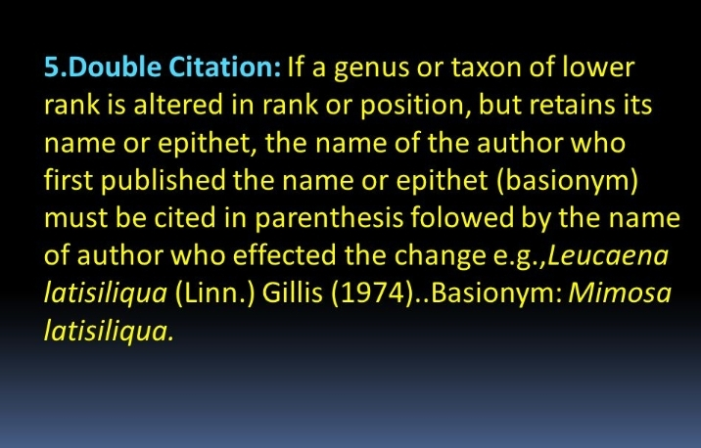

Slide 25
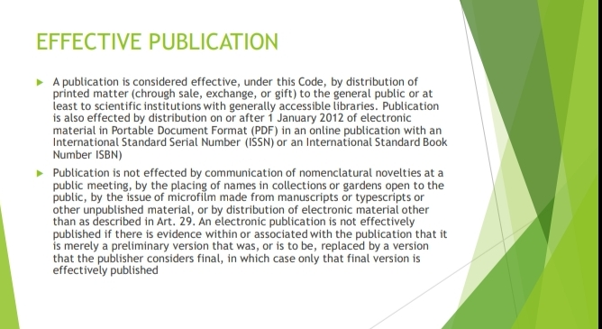

Slide 26
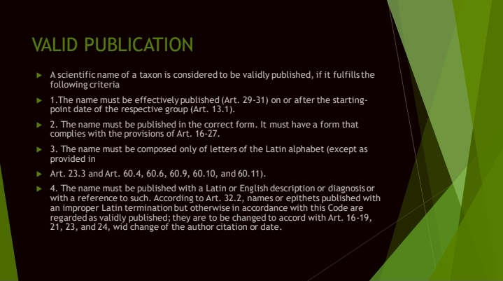

Slide 27
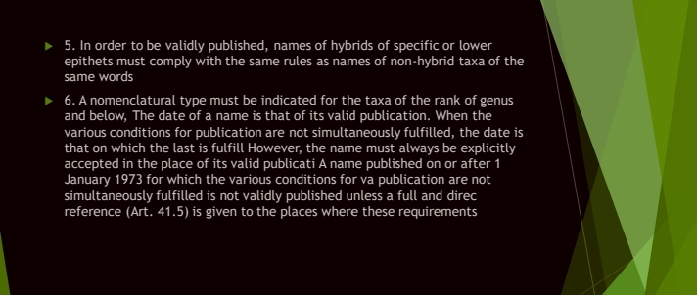

Slide 28
Rejection of names
a legitimate name or epithet must not be rejected merely because it is inappropriate or disagreeable, or because another is preferable or better known, or because it has lost its original meaning. However, a name must be rejected if it was nomiendaturally superfluous when published. Similarly, a name or epithet rejected is replaced by the oldest legitimate name or in a combination by the oldest available epithet in the rank concerned. The following types of name can be considered to be illegitimate & unusable.

Slide 29
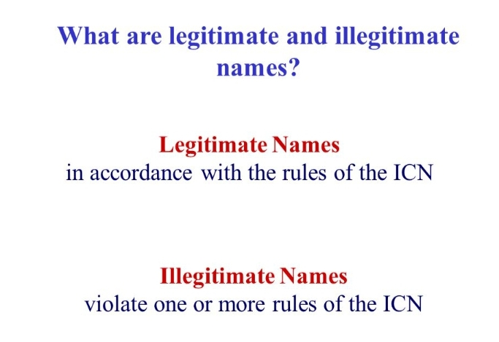

Slide 30
◆ PRINCIPLE OF PRIORITY (Chapter II; Articles 11-12)
262
The third principle of the ICN is priority of publication. It states that out of two ot merve competing taxa for a name, the one published validly first is the correct one. Priority of date to the author who validly p publication applies only to the taxa at the rank of family and below. The principle of priority ferved spelling c vascular plants starts from 1 May 1753 with the publication of Specia Plantarum by Linnana The names published prior to that date are not considered for priority.

Slide 31
Name changes
The name changes can occur for only two reasons: (1) Because of the recognition that one name is contrary to the rules and (ii) Because additional taxonomic evidences have resulted in a change of the definition and delimitation of a taxon. This process is known as taxonomic revision.

Slide 32
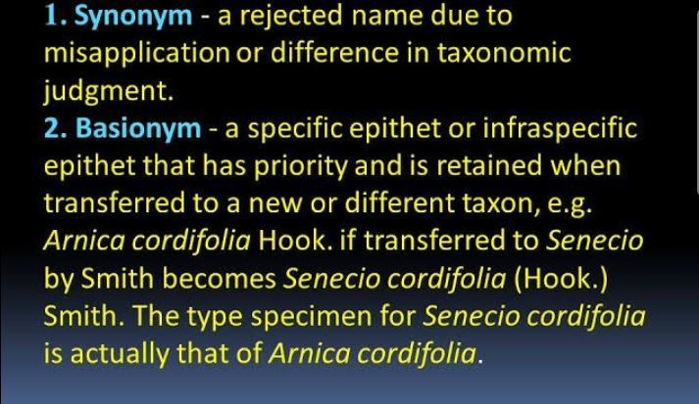

Slide 33
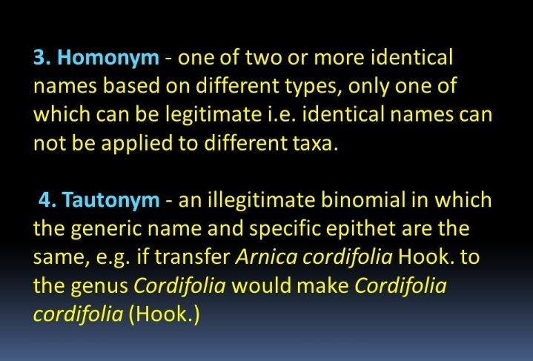

Slide 34
